Slide 1
Using UAS Orthomosaic Imagery
in GIS Field-Study Applications
Measuring the accuracy of UAS-acquired imagery
Meiduo Ji, Robert Quinn, Chase VanSchoonhoven

Slide 2
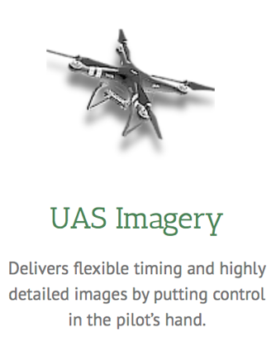
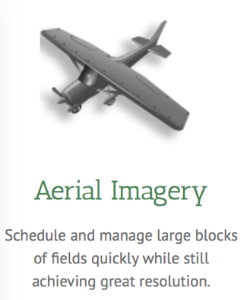
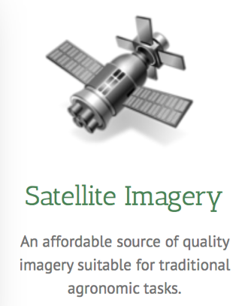
Background
Traditional imagery basemaps are most often derived from satellite or aerial imagery from manned aircraft. While increasing in popularity and availability, Unmanned Aerial Systems (UASs) are still not widely used as a source of high-resolution imagery basemaps. Given their technological capability, UAS should be considered a valuable asset in any GIS-intensive field research project.
The georectified mosaics created from UAS are accurate for most non-survey level projects, and provide a significantly higher resolution than satellite and aerial imagery, allowing for more intelligent insight to be extracted from the raster.
Spatial Data Acquisition | 2
SECTION TITLE | 2

Slide 3
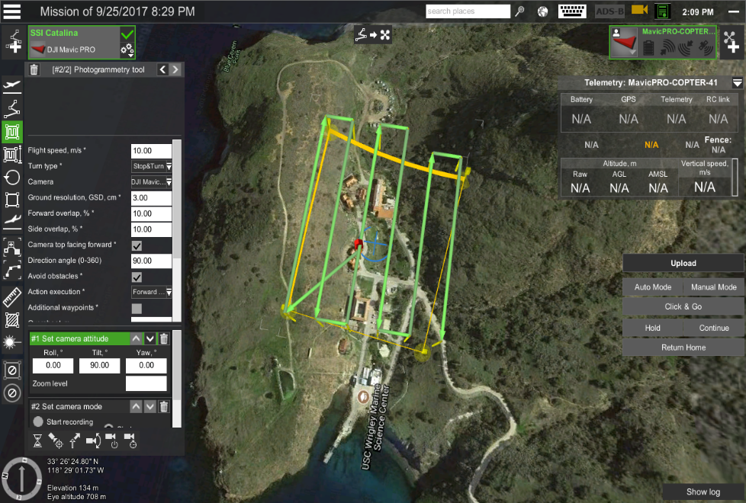
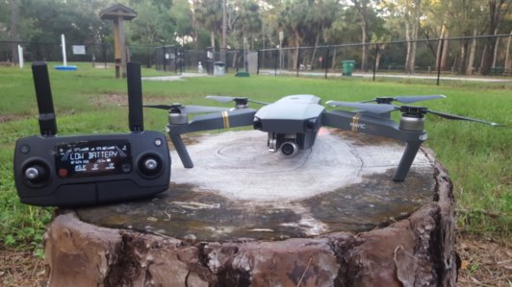
Project Proposal
This project aimed to measure the accuracy of orthomosaic imagery acquired from a UAS platform to aide in GIS field research applications. The quality of imagery was tested, and compared to other conventional imagery sources such as satellite and manned aerial platforms. The research was conducted at the Wrigley Marine Institute on Catalina Island by USC students in the GIST Masters Program.
Spatial Data Acquisition | 2
SECTION TITLE | 2

Slide 4
Methodology
Created Ground Control Points (GCP) and mapped their location using the Trimble Geoexplorer 6000.
Ground truthed features using the Trimble Juno T41/5.
Imported features using TerraSync into GIS.
Executed flight plans with the DJI Mavic Pro.
Uploaded UAV imagery and processed it into a orthomosaic tif with Pix4D.
Imported features into GIS, and digitized them from the orthomosaic tif.
Used the Near tool to do a comparison between the digitized GCP and the actual feature coordinates.
Compared satellite, archived Catalina aerial imagery, UAS orthormosiac archived Catalina aerial imagery side-by-side.
Did a visual comparison of the polygons created from the Juno and orthomosaic, and assessed the accuracy of the Juno in polygon creation.
Spatial Data Acquisition | 2
SECTION TITLE | 2

Slide 5
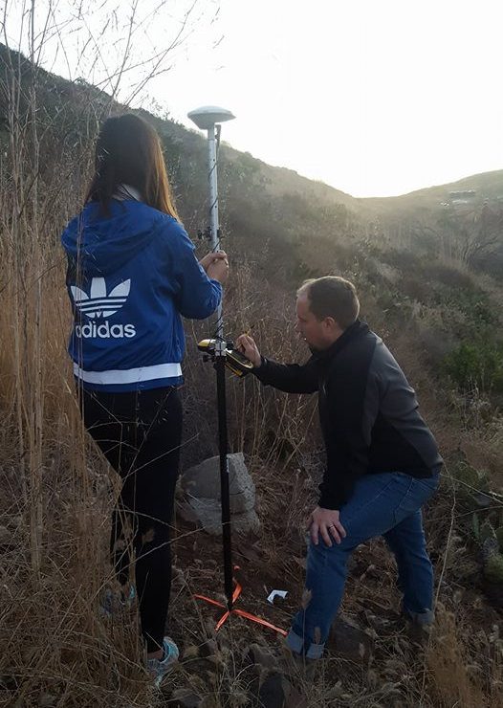
Proposed vs Actual Methodology
The execution of this project closely followed the proposed methodology with the exception of two minor deviations.
The first two flights were aborted in-flight due to technical difficulties. On the third attempt, the forward and side overlap were adjusted from 10% to 30%.
The cloud-based orthorectification output tif images were very distorted. We switched to locally-processing imagery in order to manually identify tie points in imagery, resulting in a significant quality increase.
Spatial Data Acquisition | 2
SECTION TITLE | 2

Slide 6
Methodology Workflow
Mission Planning
Create Ground Control Points and Features
Autonomous Imagery Acquisition
UAS Recovery and
Image Processing
Post Processing and Comparative Analysis
Spatial Data Acquisition | 2
SECTION TITLE | 2

Slide 7
Equipment and Software
EQUIPMENT
DJI Mavic Pro
Trimble Juno T41/5
Trimble Geoexplorer 6000 Series
Vertex Aviation Transceiver
SOFTWARE
TerraSync
UgCS
Pix4D
QGIS
ArcGIS Pro
Zello
Spatial Data Acquisition | 2
SECTION TITLE | 2

Slide 8
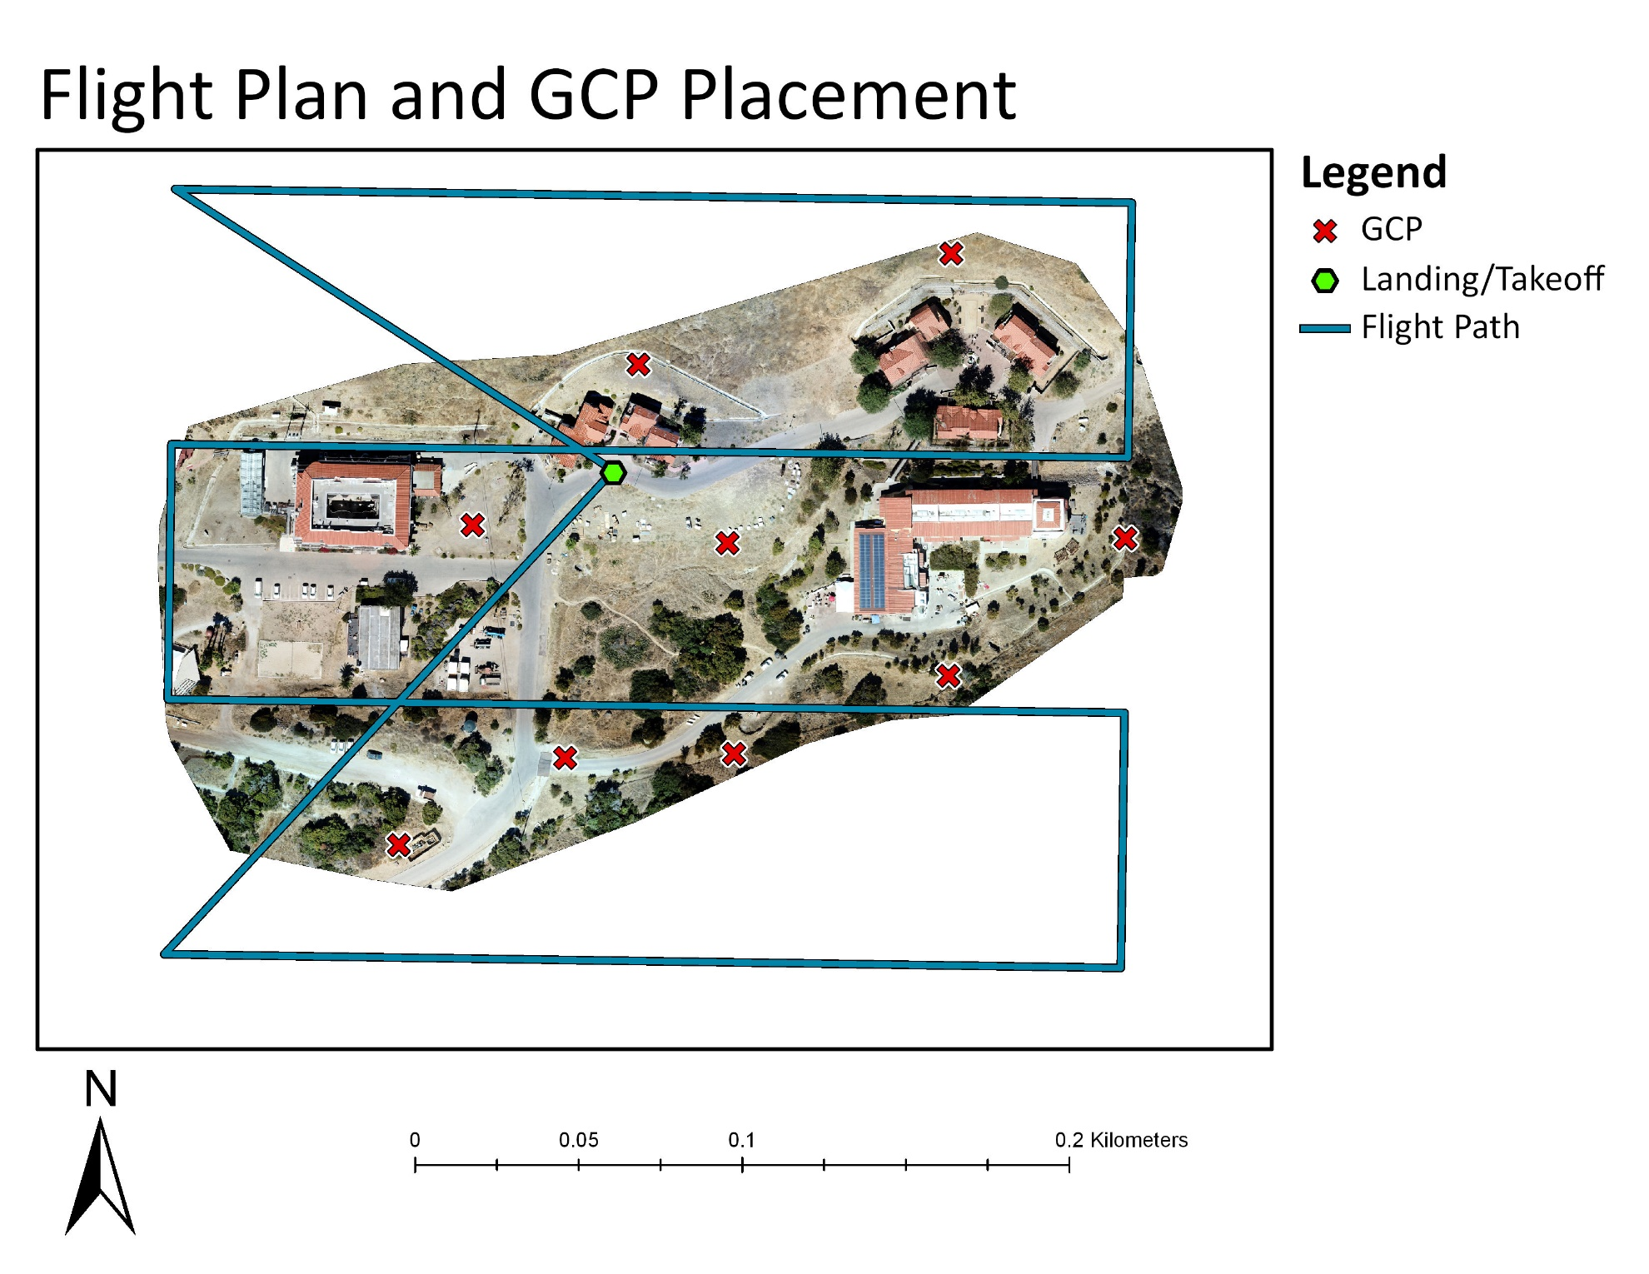
Mapping The Execution

Slide 9
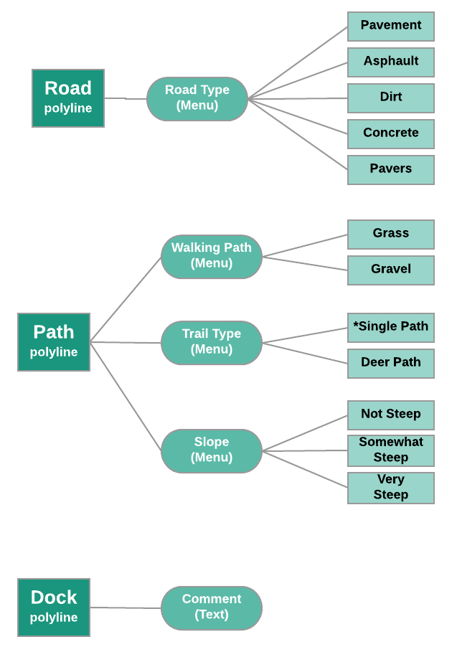
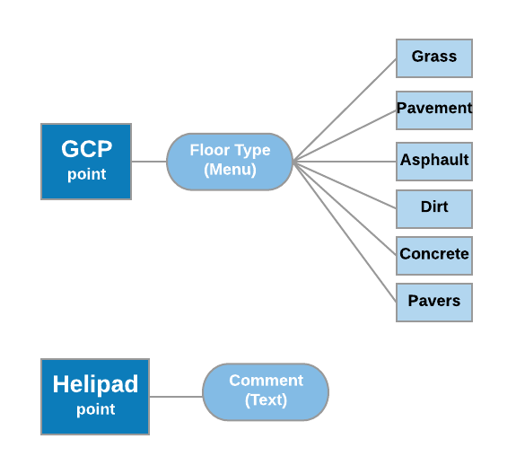
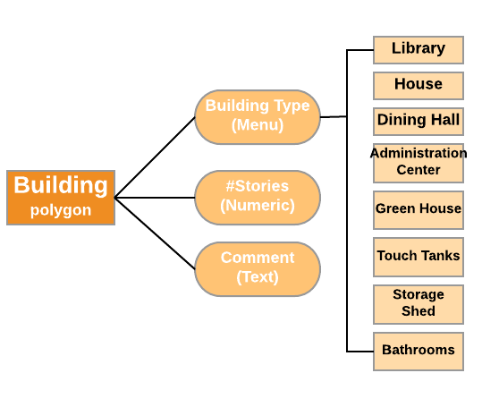
Data Dictionary
Spatial Data Acquisition | 2
SECTION TITLE | 2

Slide 10
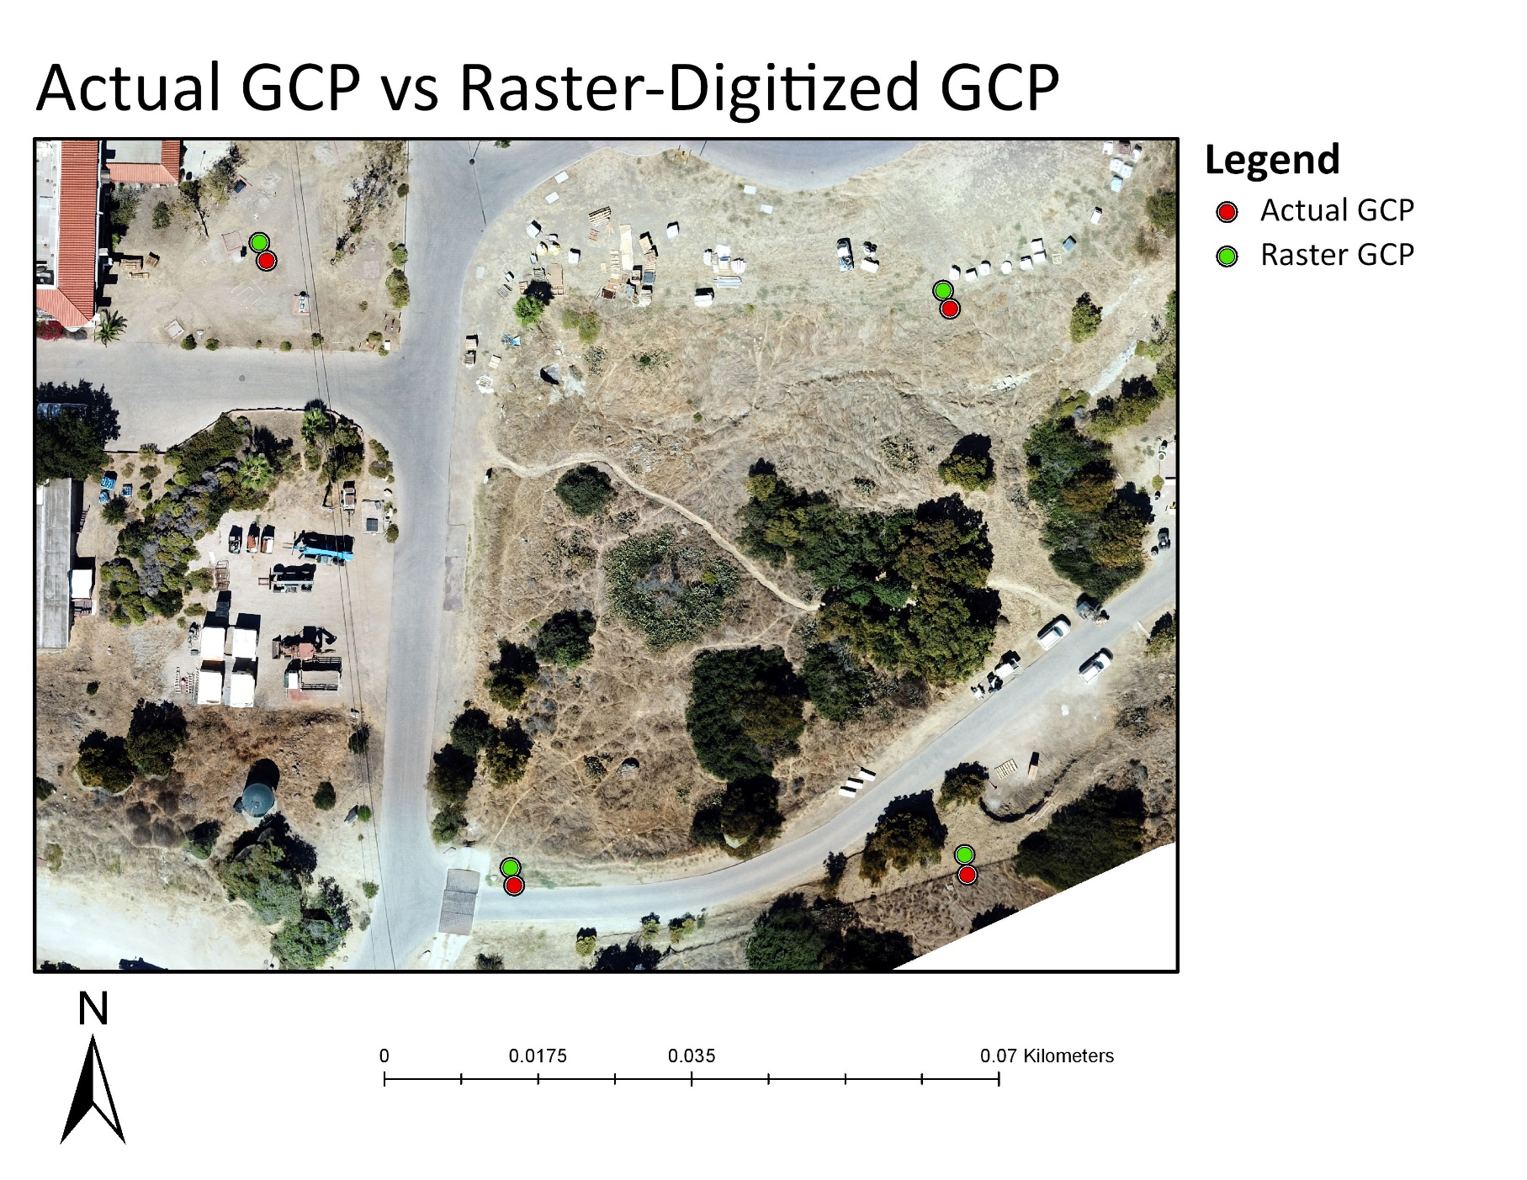
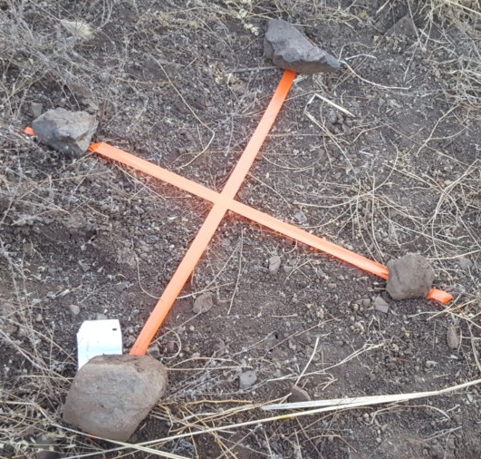
Mapping The Execution

Slide 11
Anticipated vs Actual Results
Anticipated Results
8m maximum distance between actual and raster GCP
4m average distance between actual and raster GCP
Overall imagery quality that justifies using UAS in GIS field-study applications
Actual Results
2.33m maximum distance between actual and raster GCP
2.07m average distance between actual and raster GCP
Imagery with convincing spatial accuracy on non-building features
Noticeable tradeoff in building feature distortion (observed in areas with sharp increases in z-value)
SECTION TITLE | 2
Spatial Data Acquisition | 2

Slide 12
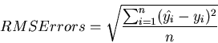
GCP Comparison (RMSE)
Disparity between the actual GCP and raster-digitized GCP was determined using the Near geoprocessing tool in ArcGIS. The output of the tool produced a distance from the raster GCP to the nearest respective actual GCP. The Root Mean Square (RMS) Error between the GCP datasets was calculated manually.
Distances in Meters
Maximum (2.331) Mean (2.071) Minimum (1.758)
To calculate RMSE: Calculate the square of each value in the NEAR_DIST column. Find the sum of the squares. Calculate the square root of the sum of the squares divided by the number of ground control points.

Slide 13
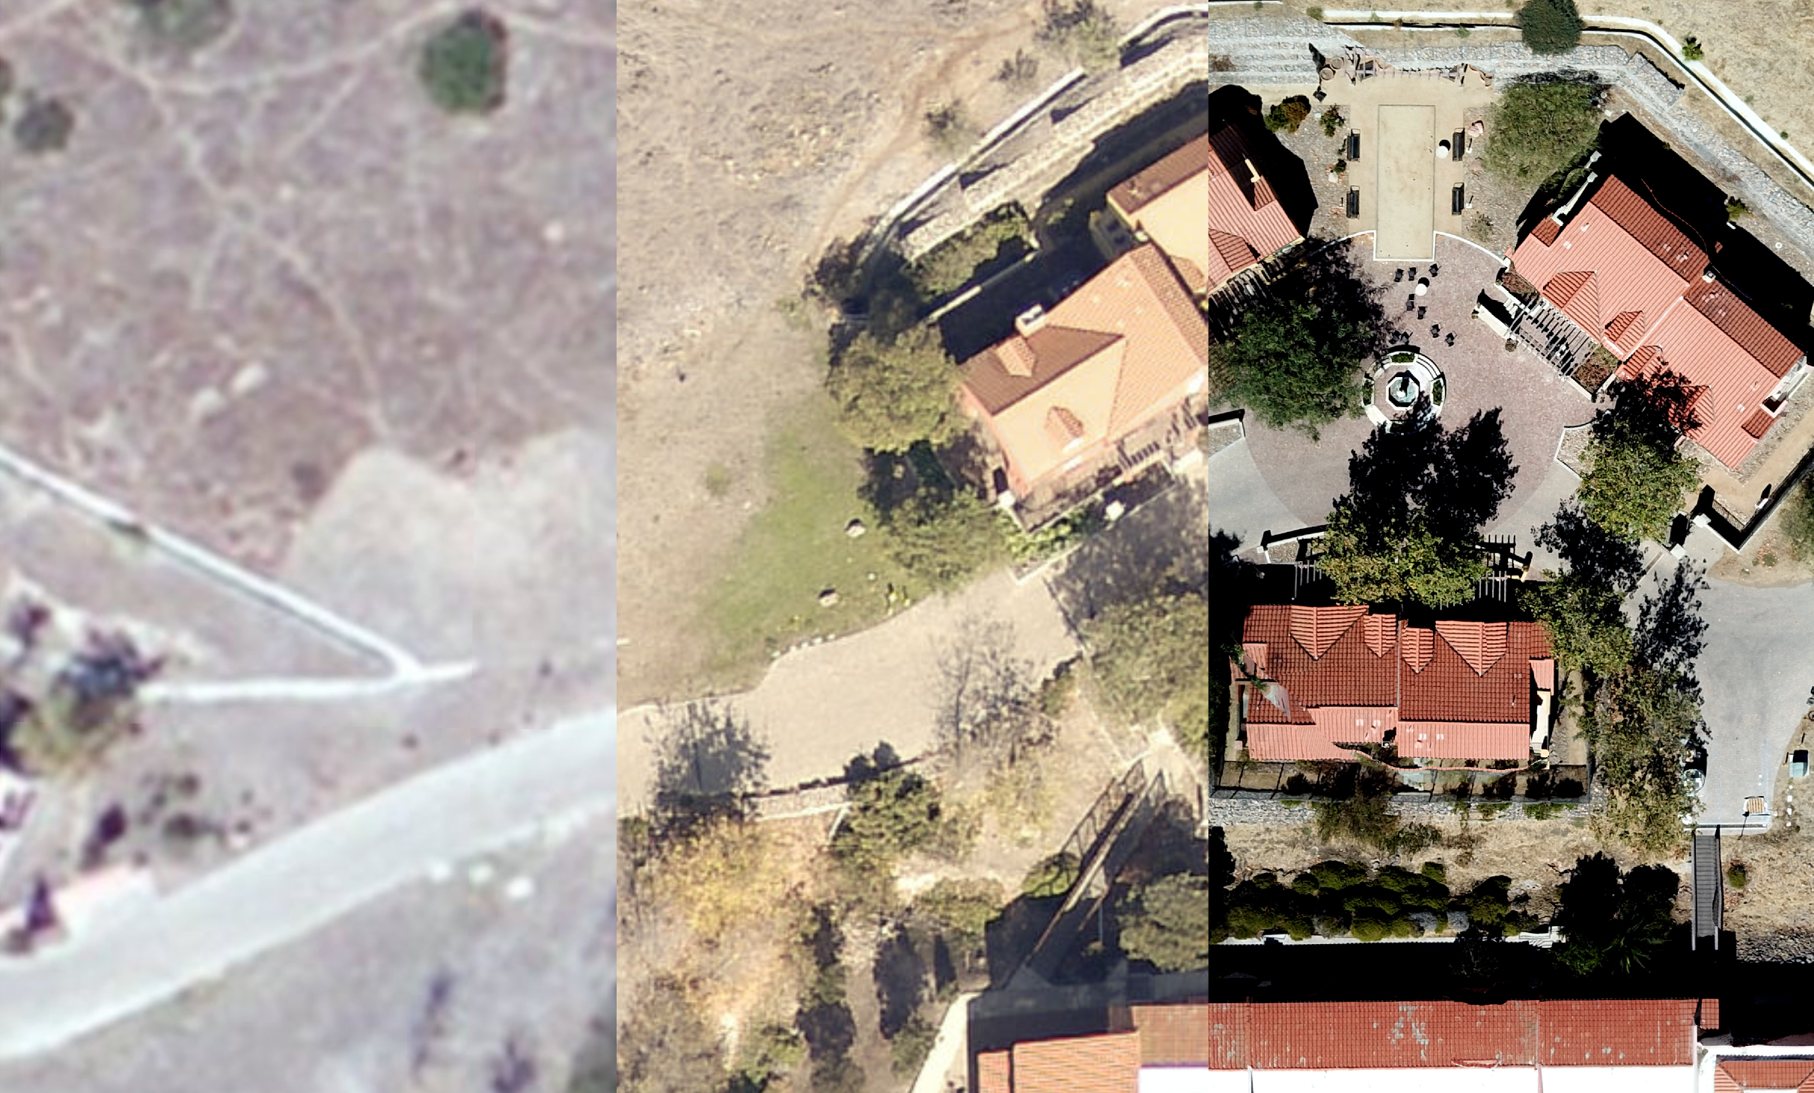
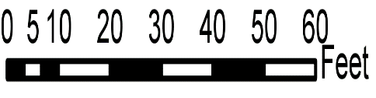
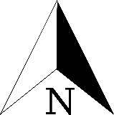
Imagery Comparisons
Satellite
Aerial
UAS Aerial

Slide 14
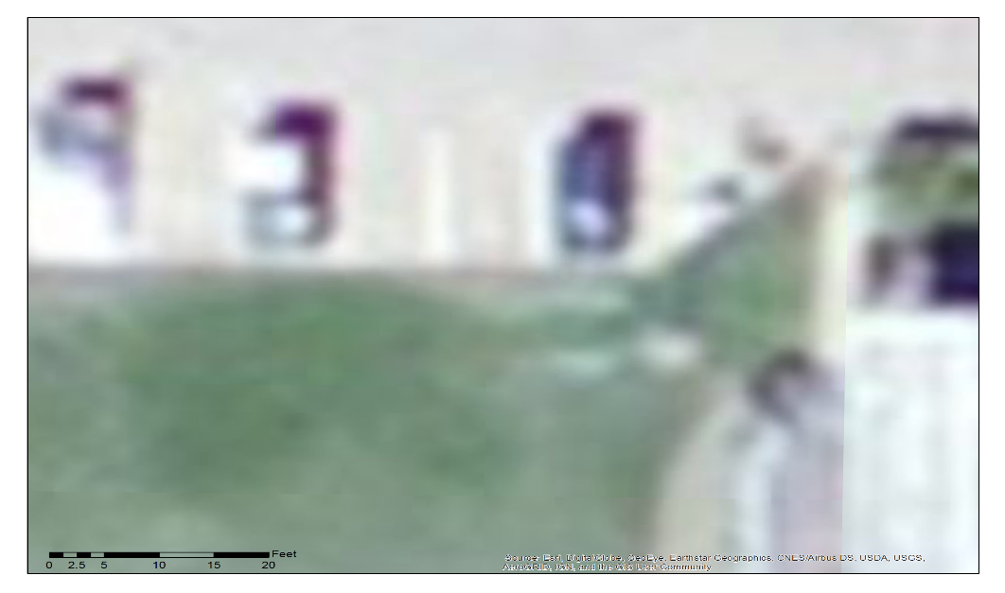
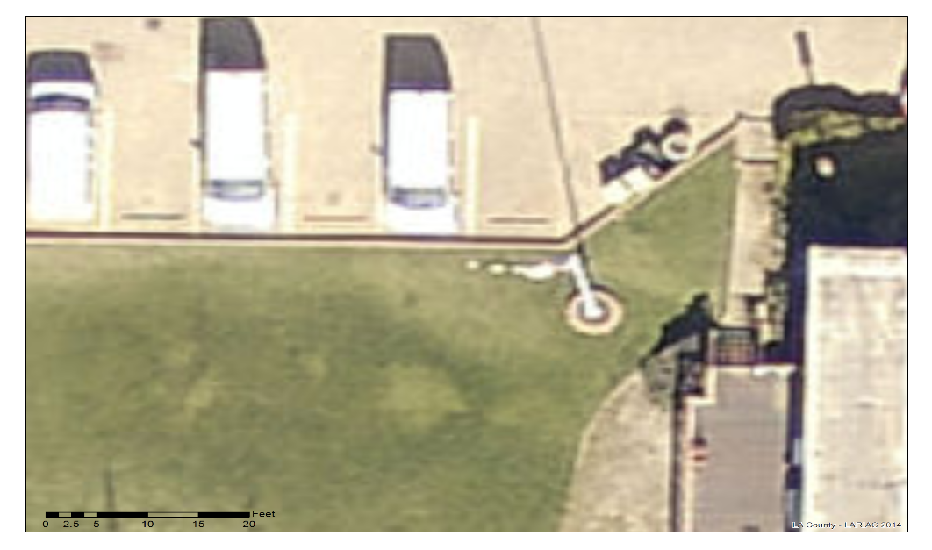
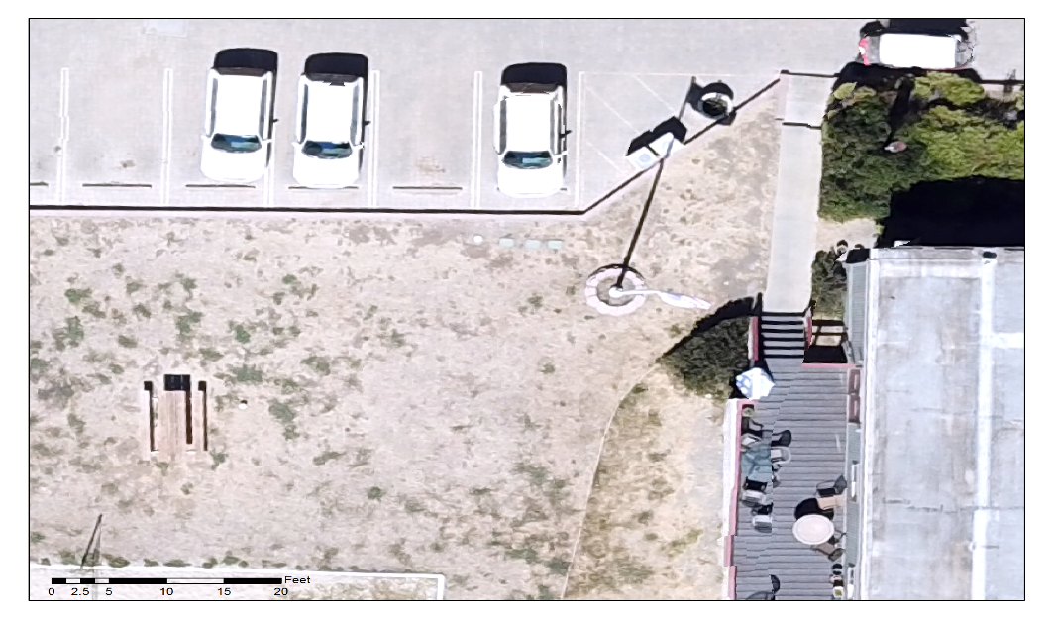
Imagery Comparisons
Potential UAS Imagery Applications
Near real-time (NRT) vehicle counting (vehicle make, model, color, condition…etc)
Counting humans and/ or animals for traffic analysis
Satellite
Aerial
UAS Aerial

Slide 15
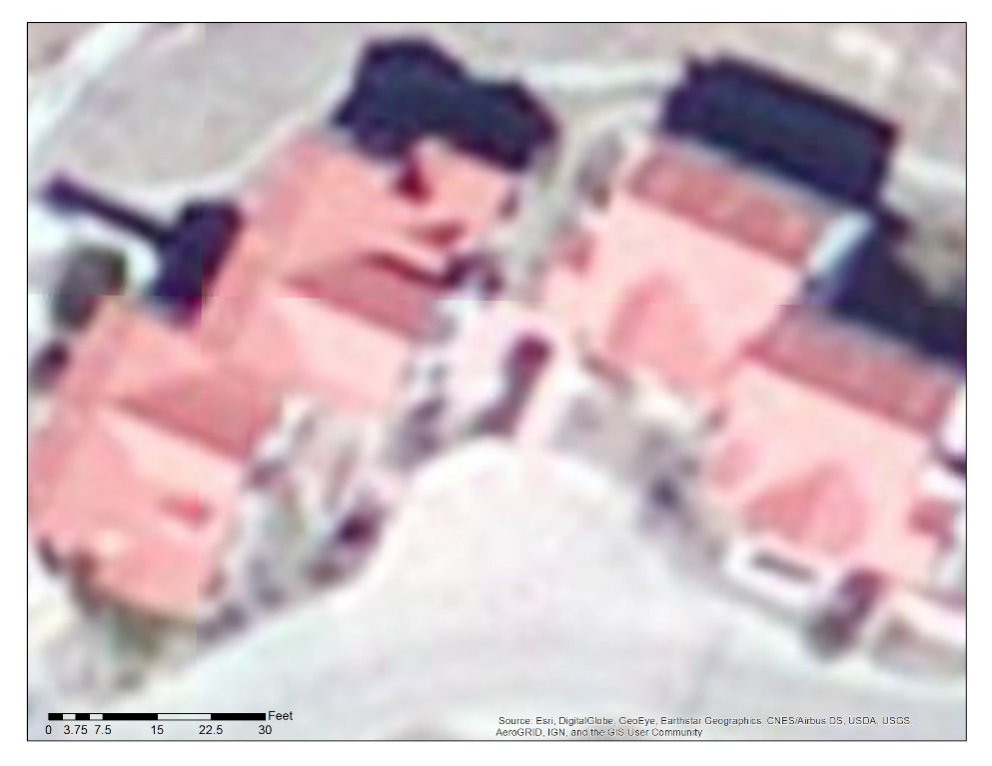
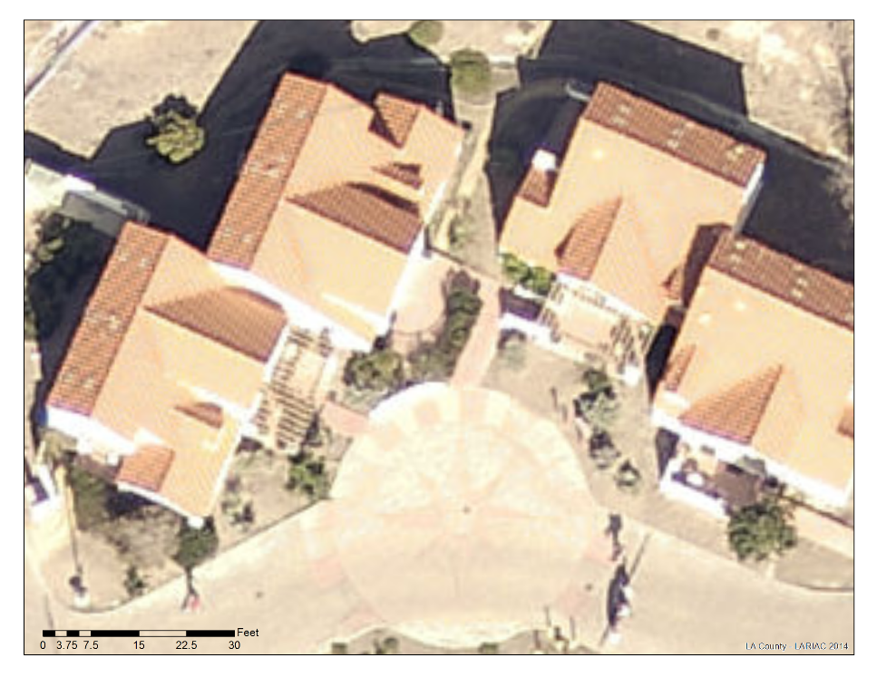
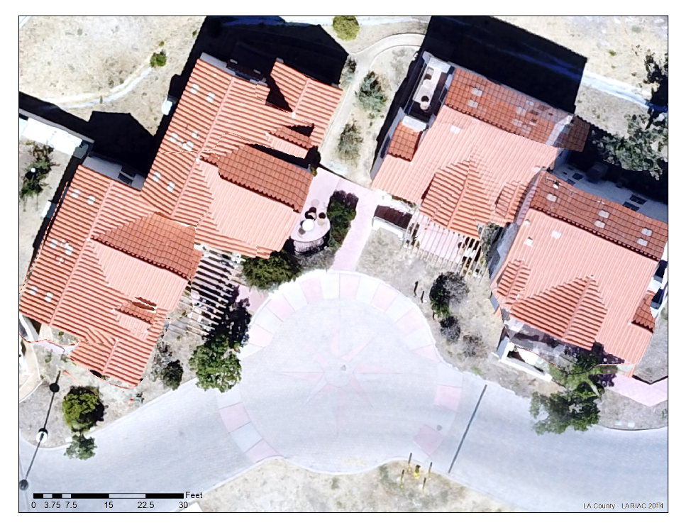
Imagery Comparisons
Potential UAS Imagery Applications
Remote roof condition inspections
Building code violation inspections
Satellite
Satellite
Aerial
UAS Aerial

Slide 16
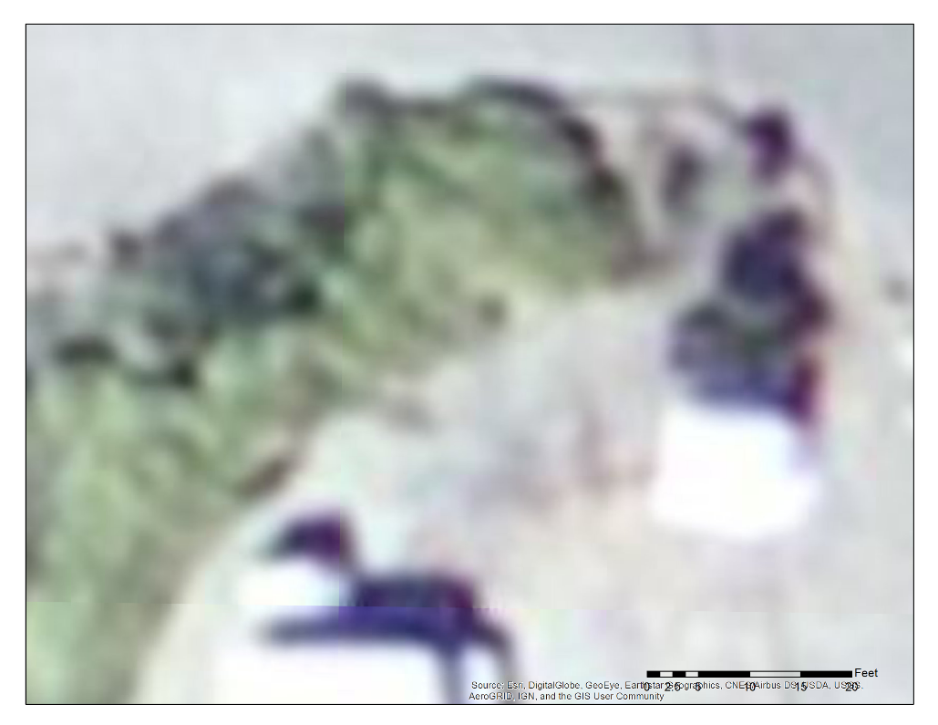
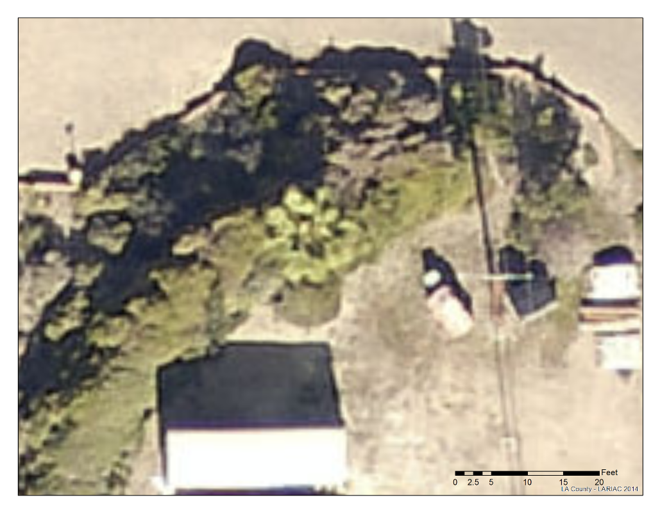
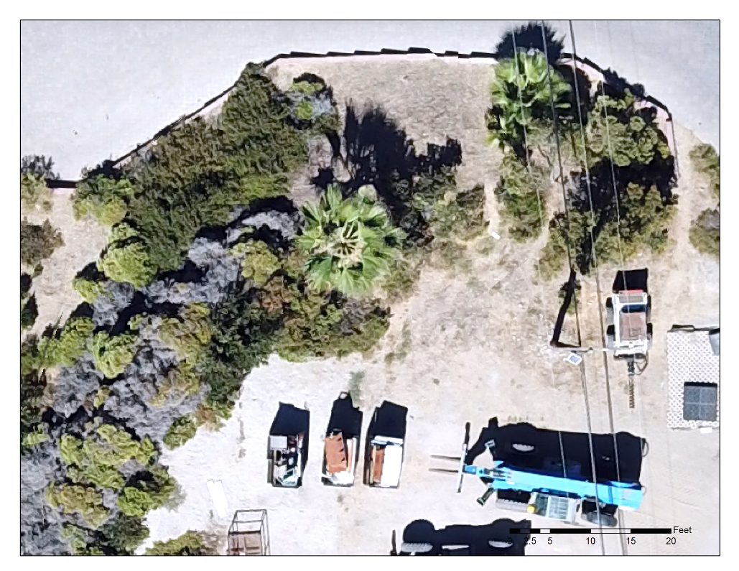
Imagery Comparisons
Potential UAS Imagery Applications
Construction site progress inspections
Environmental regulation enforcement
Satellite
Satellite
Aerial
UAS Aerial

Slide 17
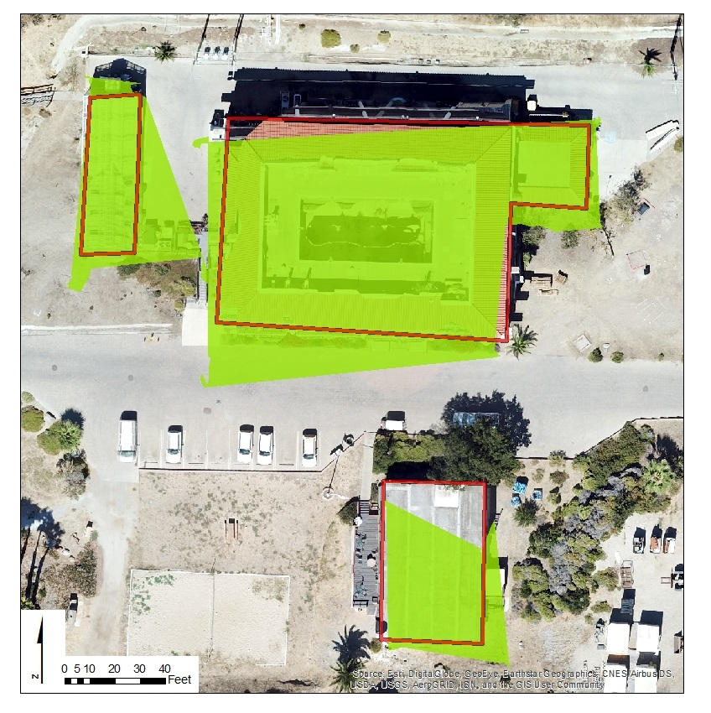
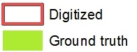
Polygon Comparisons

Slide 18
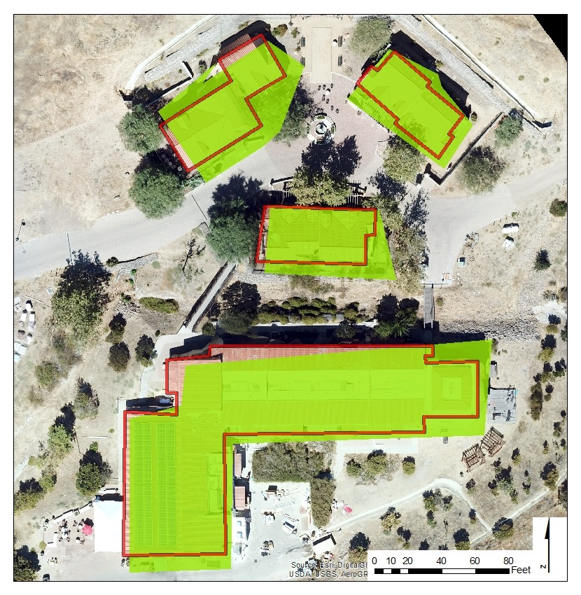
Polygon Comparisons

Slide 19
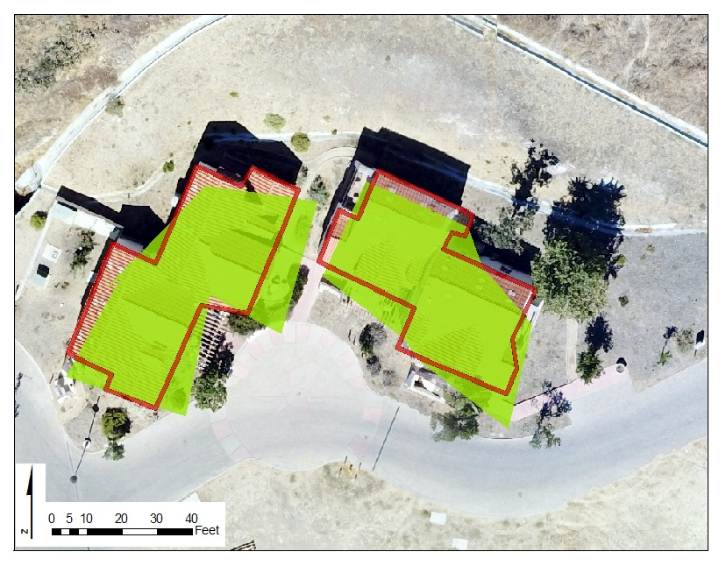
Polygon Comparisons

Slide 20
Polygon Accuracy Using Trimble T41/5

Slide 21
SWOT Analysis
Strengths
Weaknesses
Threats
UAS Social Stigma
Opportunity
Spatial Resolution
Temporal Resolution
Ease of Acquisition
Cost of Acquisition
UAS Knowledge
Weather Limitations
Distortion
Software Learning Curve
Expands potential POI
New Applications
Scalable
Safety Concerns
Regulatory Infractions
Security Threats
New Technology
SECTION TITLE | 2
Spatial Data Acquisition | 2

Slide 22
Lessons Learned
There was significant building distortion with 30% front and side overlap at 3 centimeter ground sample distance (GSD)
Distortion would be decreased with increased overlap and a lower GSD
Local orthorectification processing requires moderate computing power, but is superior to current cloud computing processes which have no manual user input
SECTION TITLE | 2
Spatial Data Acquisition | 2

Slide 23
UAS Flight Safety Considerations
Because the project incorporated UAS Operations, we took precautions to ensure the safest possible outcome for the project. Below is a list of the considerations.
The UAS pilot holds a commercial UAS certificate from the Federal Aviation Administration (FAA). The pilot checked the airspace to ensure safe and legal operation in accordance with FAA regulations prior to the flight.
The UAS pilot used an aviation transceiver to announce UAS operations and monitored for any local aircraft traffic.
An unmanned operating area was established and an official Notice To Airmen was filed with the appropriate flight service station for the flight.
The UAS crew consisted of an observer who served as a lookout. The observer communicated with the pilot via a radio application on their phones.
The hyperbaric chamber staff was notified of the window of UAS flight operations, as well as the flight plan polygons.
The UAS lost communications procedures included a home point at the takeoff point (if the aircraft stops communicating with the controller, it automatically flies back home with obstacle avoidance engaged).
SECTION TITLE | 2
Spatial Data Acquisition | 2

